Slide 1



E-Waste Generation Classification

Slide 2

Learning Objectives:
Data understanding & Pre-processing :
The e-waste image dataset is prepared by cleaning for accuracy and organizing
it properly. The folder structure is also understood to correctly identify image
class labels.
Exploratory Data Analysis:
The image are visually checked to understand their types, class distribution, and any
imbalance in the number of images per class. This helps find challenges like very
similar or confusing classes.
Feature Engineering using Transfer Learning:
A pre-trained model like EfficientNetV2B0 is used to extract features from images.
This saves time and gives good results because the model has already learned from
a large dataset like ImageNet.
Applying Machine Learning Algorithm:
The EfficientNetV2B0 model is customized for the e-waste classification task by
adding new layers.it helps reduce training time and improves performance using deep
learning methods.
Model Training and Evaluation:
The model is trained using the dataset, and its accuracy and loss are tracked.Later,it is
tested on new images, and performance is checked using confusion matrices and
classification reports.
GOAL

Slide 3
Tools and Technology used :
Python 3.x
Jupyter notebook
Python
used as the primary programming language for data preprocessing,exploratory data
analysis, and implementation of machine learning algorithm.Python’s libraries,such
as numpy,matplotlib,scikit-learn, and others,facilitated efficient data manipulation
,visualization,and model development.
TensorFlow & Keras
user for constructing,training,and fine-tuning deep learning model.the efficientNetv2B0
architecture was implemented using keras within the TensorFlow framework.
Pillow(PIL)
used for constructing training,and fine-tuning deep learning models.The efficientNetv2B0
architecture was implemented using keras withinthe tensorflow framework.
Gradio
used the gradio library to develop user-friendly web interfaces for deploying and interactively
testing machine learning models.
Jupyter notebooks
used for an interactive and collaborative coding environment.jupyter notebooks provided
a seamless platform for code execution,visualization, and documentation.

Slide 4
y
Methodology
1. Dataset Preparation
Collected from Kaggle: 10 classes of e-waste (e.g., Mobile, Keyboard, PCB, etc.)
Balanced split into Train (2400), Validation (300), and Test (300)
2.Data preprocessing
Resizing:128*128 pixels
Rescaling:Normalize pixel values from 0-255 to 0-1
Augmentation:Random flip,rotation,and zoom to avoid overfitting
Normalization:used preprocess_input() for EfficientNet compatibility
3.Transfer learning with EfficientNetV2B0
Used pre-trained EfficientNetV2B0(on imageNet)
Removed top layers
4.Model Fine-tuning
Froze first 100 layers to preserve general features
Trained remaining layers+new classification head
5.Training setup
Optimizer:Adam(Ir=0.0001)
Loss Function:SparseCategoricalCrossentropy
Metric:Acccuracy
EarlyStopping:patience=3,restored best weights

Slide 5
Problem Statement:
Electronic waste(e-waste) is increasing rapidly due to the fast-paced
growth of technology. Disposing of e-waste improperly poses serious
environmental and health hazards because it contains both valuable and
toxic materials.
Manual classification of e-waste for recycling is:
Time-consuming
Error-prone
Inefficient on a large scale
There is a critical need for an automated image classification system that can quickly and accurately identify e-waste types to improve recycling efficiency and promote sustainable waste management

Slide 6
Solution:
Develop an AI-based image classification model using Transfer
learning with EfficientNetV2B0
The model automatically identifies and classifies 10 different e-waste categories from images.
Use deep learning techniques to leverage pre-trained features from ImageNet, ensuring high accuracy with limited data.
Apply data augmentation and fine-tuning to improve model generalization and prevent overfitting
Deploy the trained model using a Gradio web interface to allow real-time testing and classification by users.
Output:
Fast and accurate e-waste classification.
Reduces manual effort and human error.
Supports efficient recycling and sustainable waste management.

Slide 7
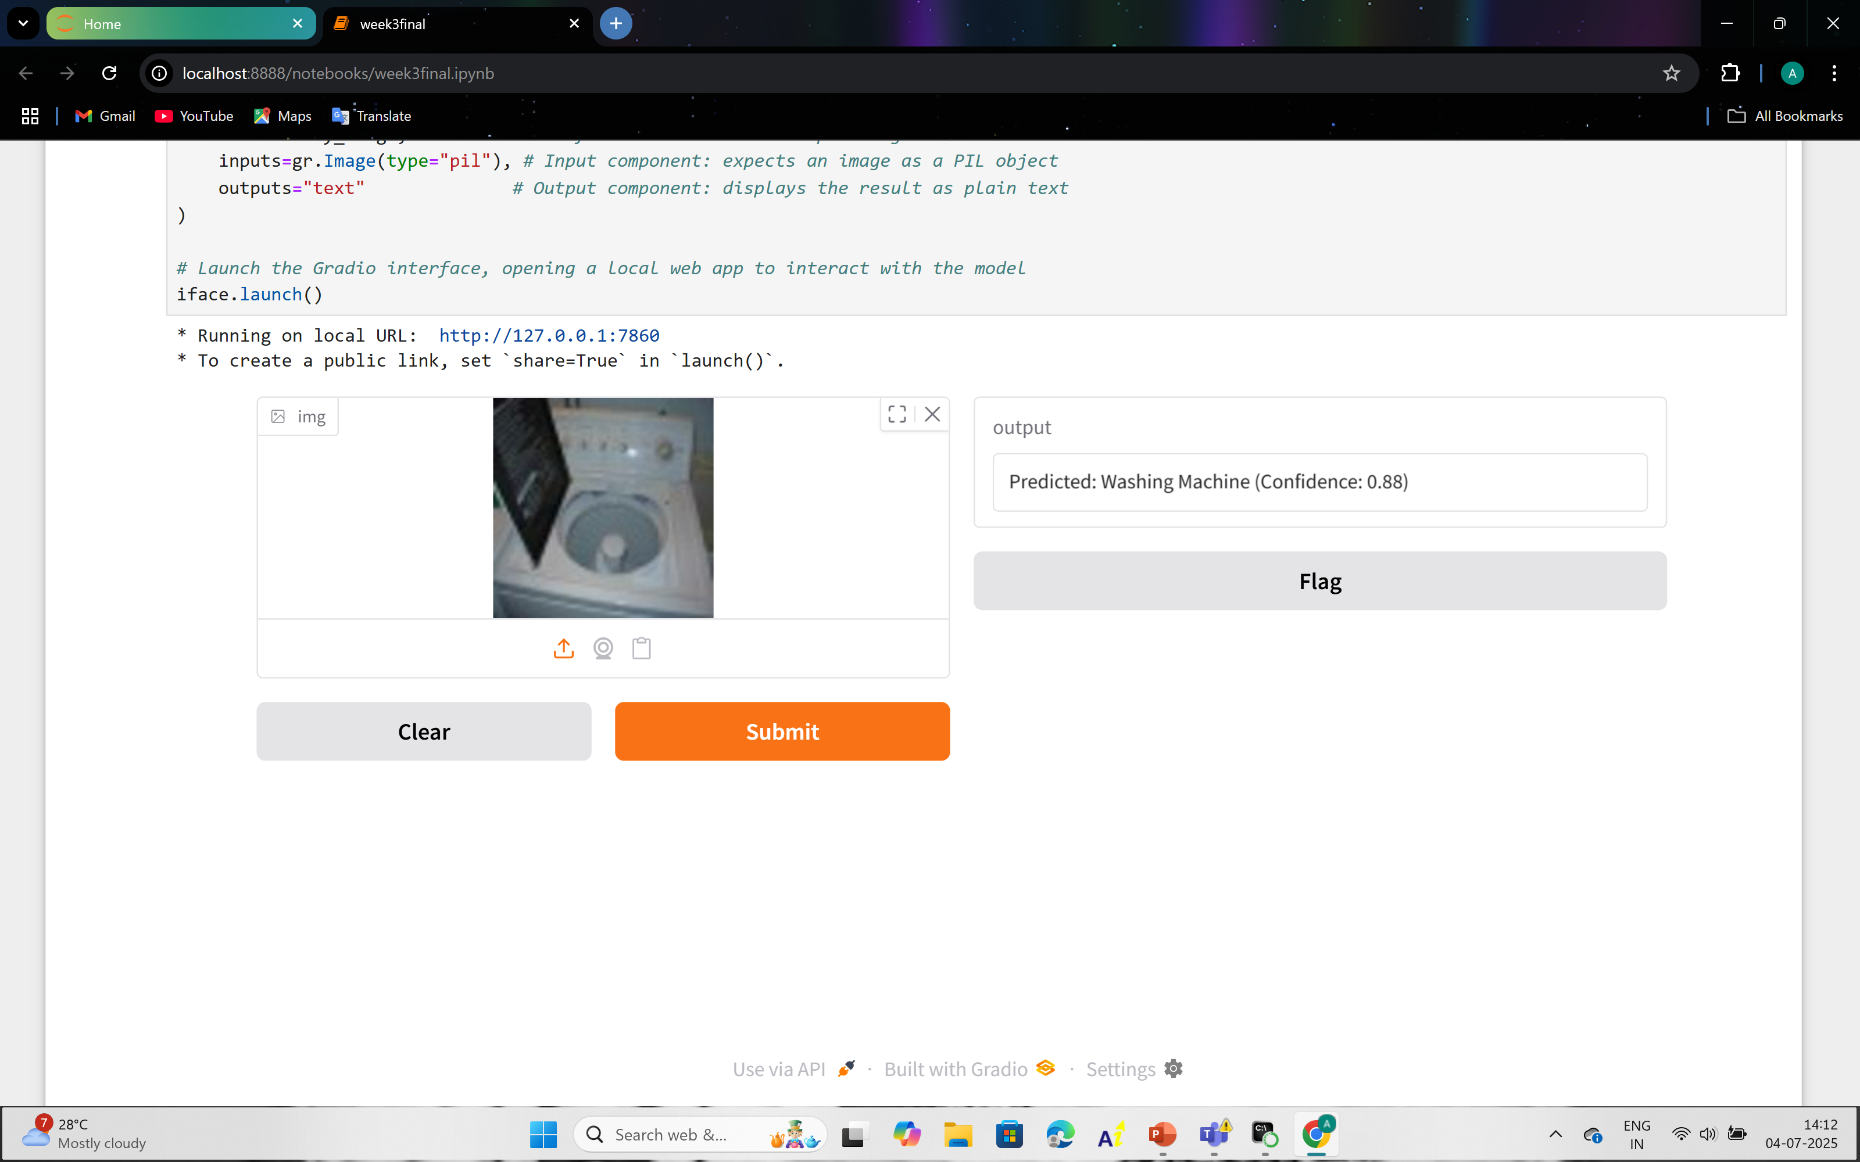
Screenshot of Output:

Slide 8
Conclusion:
The project successfully achieved its objective of developing an accurate and
Efficient automated system for classifying e-waste images using the EfficientNetV2B0
Model and transfer learning.By leveraging a well-balanced dataset and advanced deep
Learning techniques,the model demonstrated strong generalization capabilities,achieving
A high test accuracy of 96% and robust performance across all 10 e-waste categories.
The work showcases the power of transfer learning in efficiently handling limited data while still delivering high classification performance.The integration of a
Gradio-based web interface further enhanced the practical usability of the model, allowing
For real-time testing and interaction.
Overall, this project presents a promising solution for automating e-waste sorting,
Contributing to more effective recycling practices and supporting environmental sustainability. Future improvements may include fine-tuning model parameters, expanding the dataset, or experimenting with more advanced architectures to further boost accuracy and performance.
Github link:
https://github.com/Amruthavennapusa072005/Ewastegenerationclassification.git

Slide 9


